Slide 1
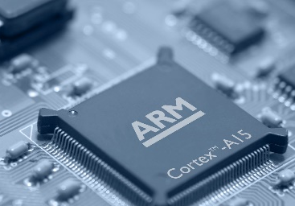
BLM206 Microprocessor Systems - Mikroişlemci Sistemleri Hafta 11: Harvard and Von Neumann CPU Architecture
Bilgisayar - Biyomedikal Mühendisliği Bölümü
Öğr. Gör. Musa AYDIN
2017 - 2018 (Bahar)

Slide 2
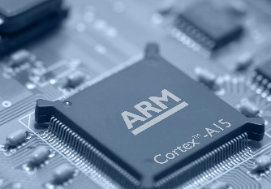
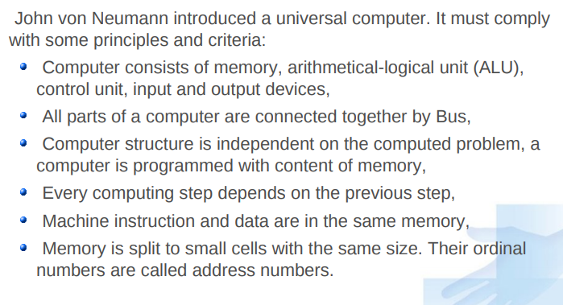
Von Neumann Architecture

Slide 3
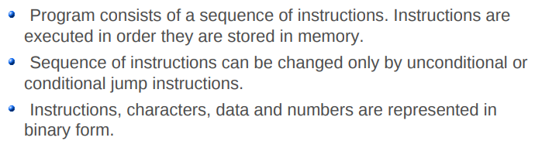
Von Neumann Architecture

Slide 4
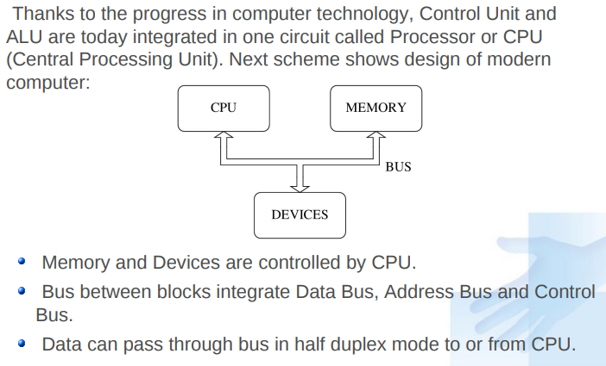
Von Neumann Architecture

Slide 5
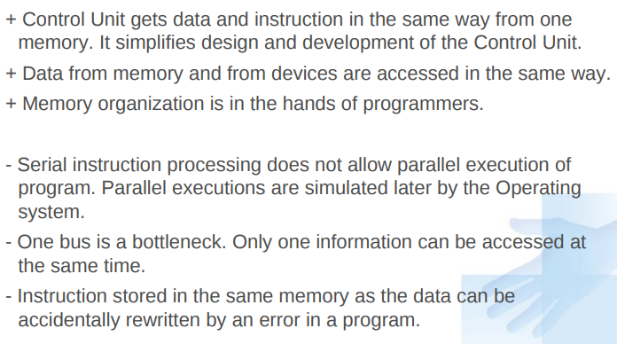
Advantages / Disadvantages of von Neumann Architecture

Slide 6
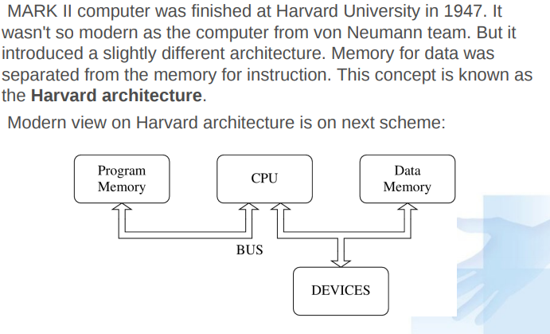
Harvard Architecture

Slide 7
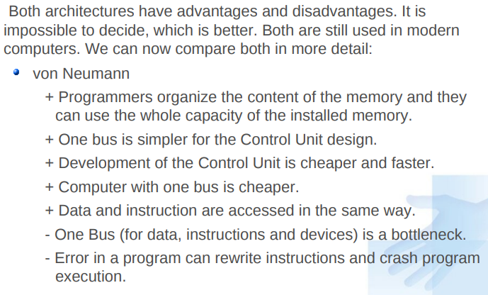
Harvard vs. von Neumann

Slide 8
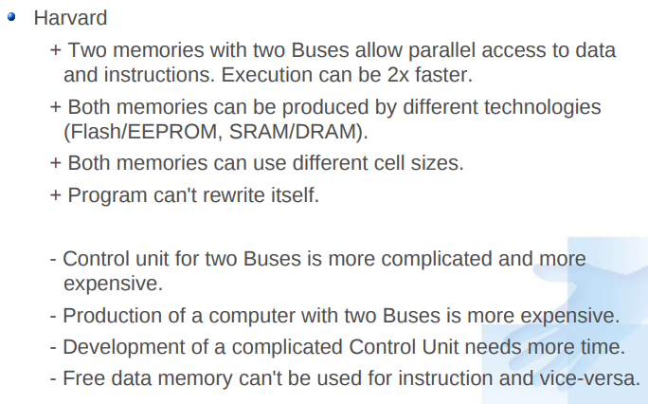
Harvard vs. von Neumann

Slide 9
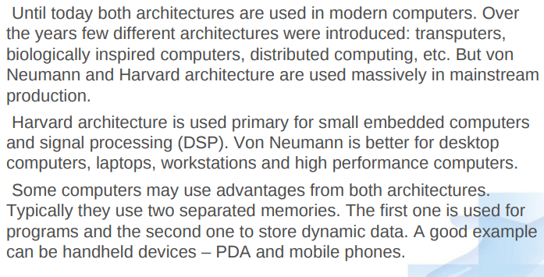
Harvard vs. von Neumann

Slide 10

Sorular

